Slide 1
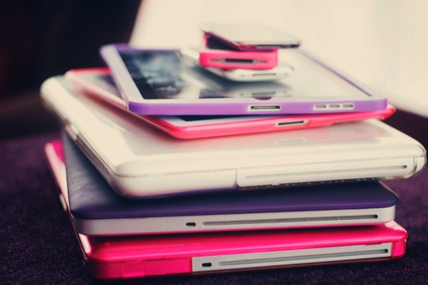
How many technology devices do you have?
By: Amandeep
and
Simi

Slide 2
Computers Vs. Laptops
We chose this question because…
Find out what was more popular
How many laptops are owned
How many computers are owned

Slide 4
SmartPhone Vs. IPod
We chose this question because…
How many people have SmartPhones
How many people have IPods
Which is more popular

Slide 6
Number of Devices in Our Class
We chose this question because…
Who has the most technology devices
Who has the least technology devices
What’s the common amount

Slide 8
Total Number of Devices
We chose this question because…
Which device is most popular
Which device Is the least popular

Slide 10
Thank you for listening!

