Slide 1
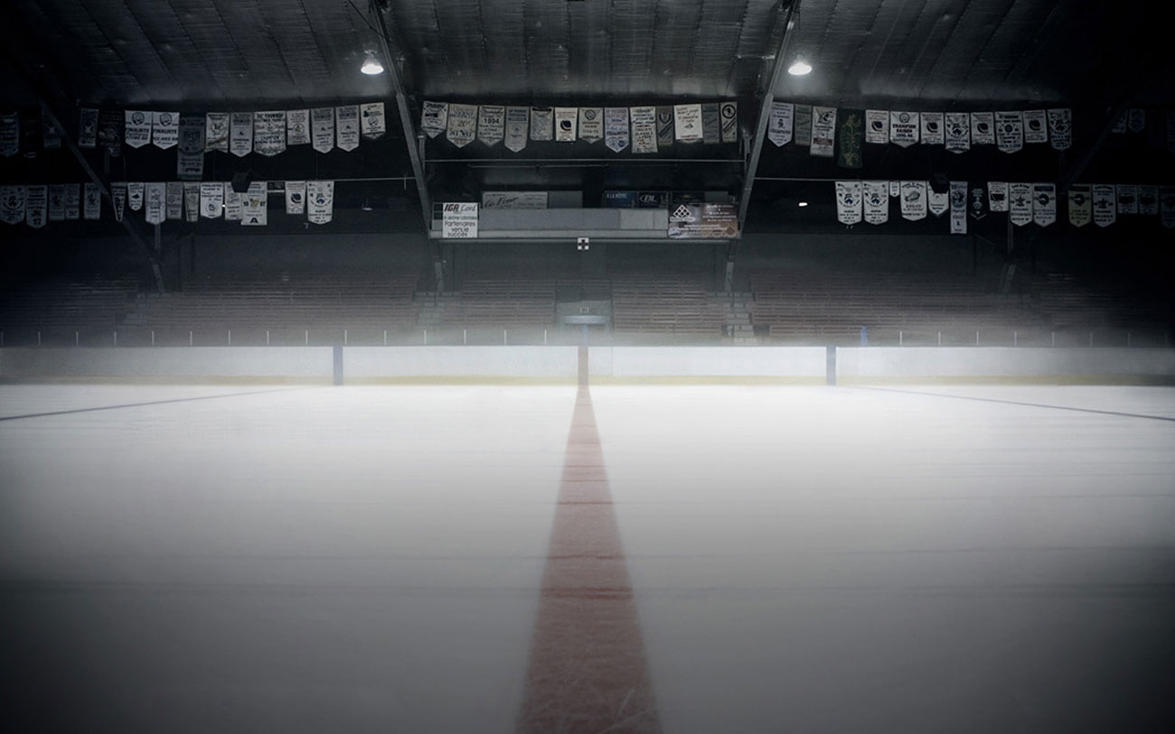
All About Me
Simi Chahal

Slide 2




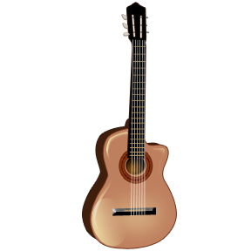


Table of Contents
Birth
Family
Favourite Things
Favourite Foods
Music
Sports
Hockey
Hobbies
Movies
T.V Shows

Slide 3
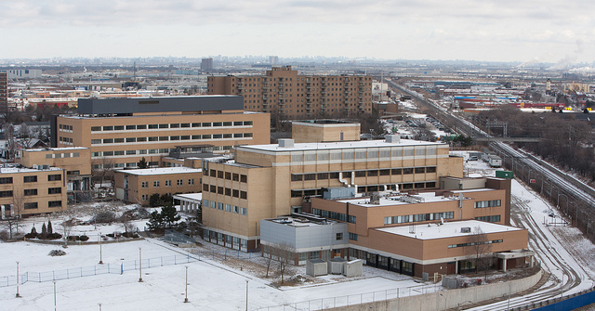

Birth
Peel Memorial Hospital
Brampton, ON
February 23, 1998
I’m a Pisces
I’m the youngest in my family

Slide 4

Family
I have two older brothers
  They’re fans of hockey
  They play in a summer league
My oldest brother is 24
The other one is 21
I’m close with my cousins

Slide 5
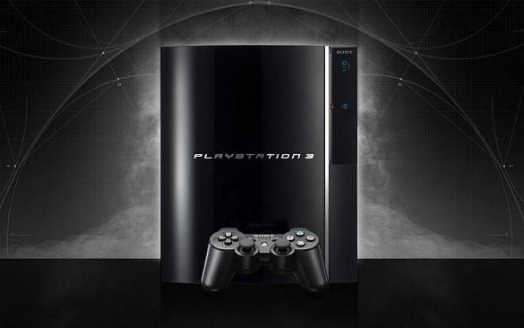
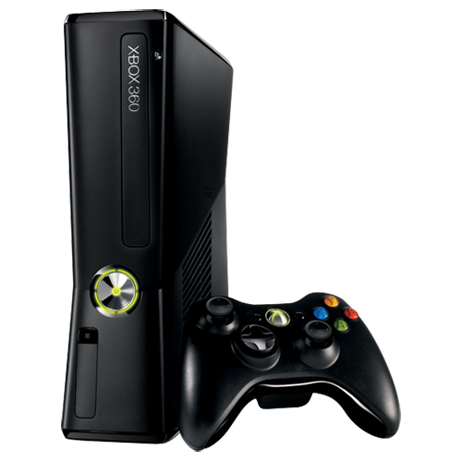

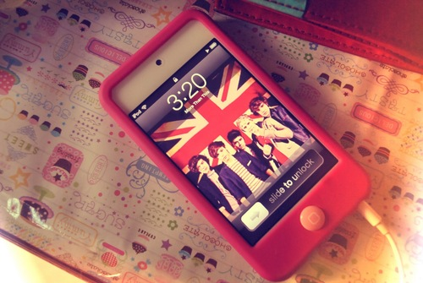
Favourite Things
I love playing both PS3 and
Xbox 360
I’m always using my Ipod
My favourite game is NHL 13

Slide 6
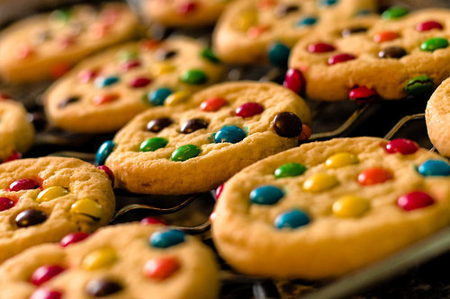
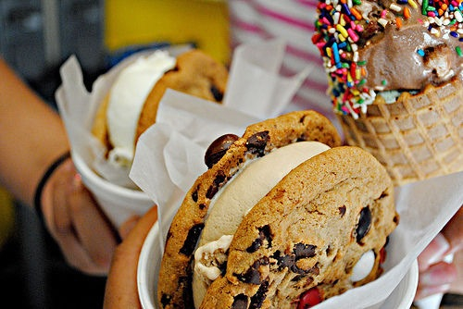
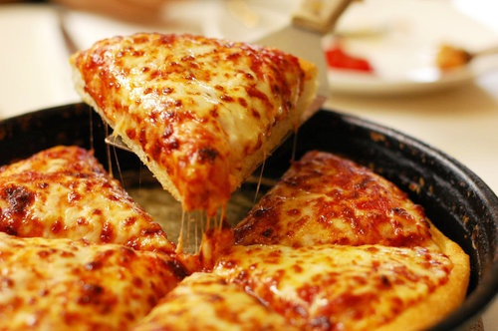
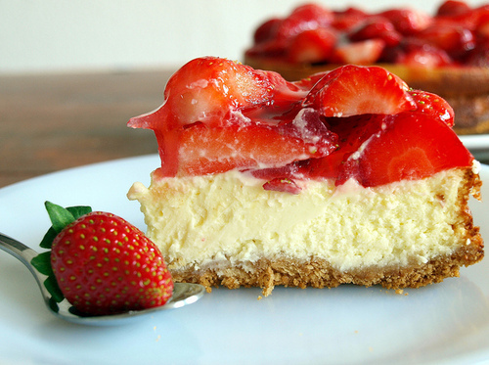
Favourite Foods
I love junk food!
I like eating healthy as well
I have too many favorite foods

Slide 7
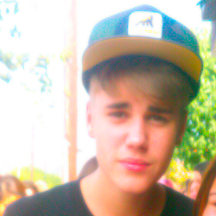
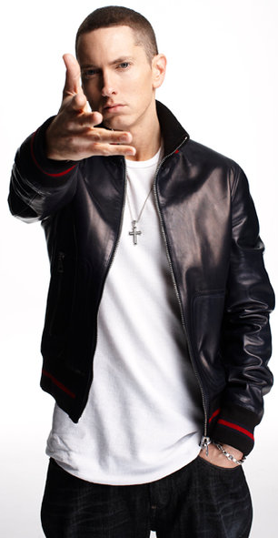
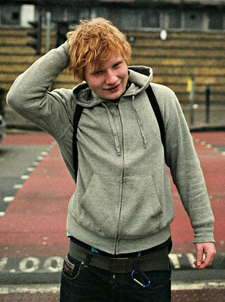
Music
I love music!
Favourite Genres: Pop, Alternative and Hip-Hop
Some favourite artists:
  Ed Sheeran
  Eminem
  Justin Bieber
  Adele

Slide 8



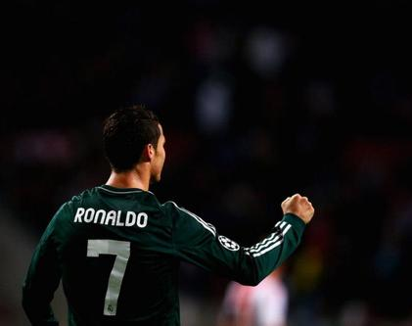
Sports
Always play soccer with my friends
Favourite teams: Portugal and Real Madrid
Favourite Player: Cristiano Ronaldo
I watch UFC

Slide 9




Hockey
My favorite team is the Detroit
Red Wings
I like the:
  Pittsburgh Penguins
  L.A Kings
  New York Rangers
I like playing outside with my
brothers
I like playing NHL 13 with my brothers

Slide 10
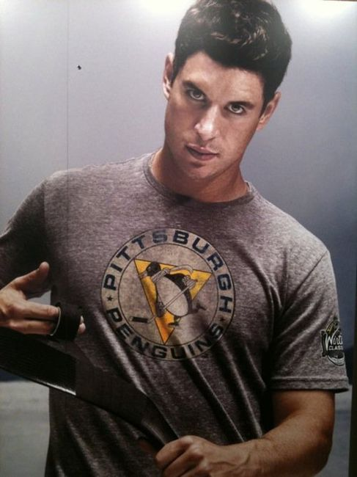
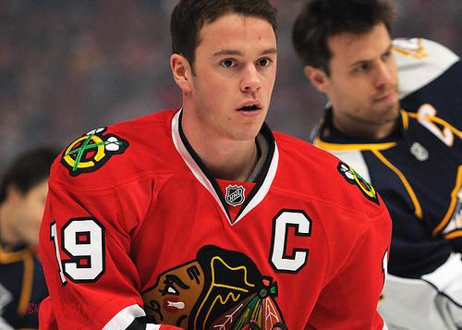
Continued…
My favourite player is Sidney Crosby
Some other players I like:
  Pavel Datsyuk
  Henrik Zetterberg
  Jonathan Towes

Slide 11
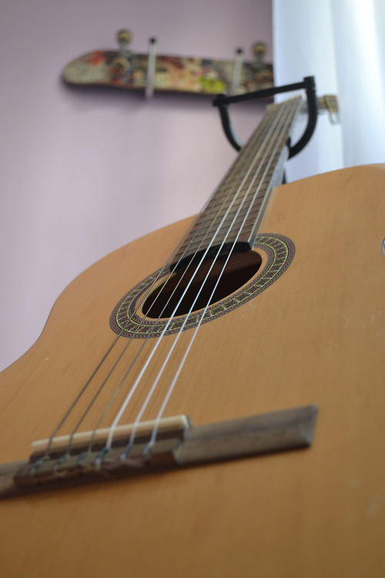
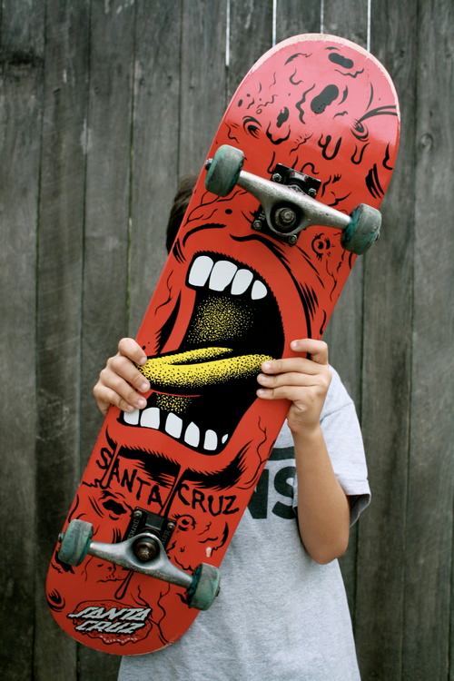
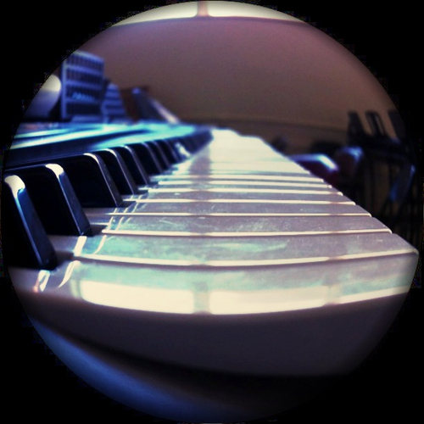
Hobbies
I like to play the piano
I’m trying to learn guitar
I like making beats
Skateboarding
Playing sports

Slide 12




Movies
I have a lot of favourite movies
The Batman movies
Genres:
  Horror
  Action
  Comedy

Slide 13





T.V Shows
Teen Wolf is my favourite
show
I also like:
  The Simpsons
  Family Guy
  That 70’s Show
  The Secret Circle

Slide 14

Thank You for Listening!
By: Simi Chahal

